Slide 1
Breadth-First-Searching (BFS)
By S.Shayan Daneshvar
June 3,2019

Slide 2
BFS
Main idea:
Look at all possible paths at the same depth before you go at a deeper level
Back up as far as possible when you reach a "dead end“
i.e., next vertex has been "marked" or there is no next vertex

Slide 3
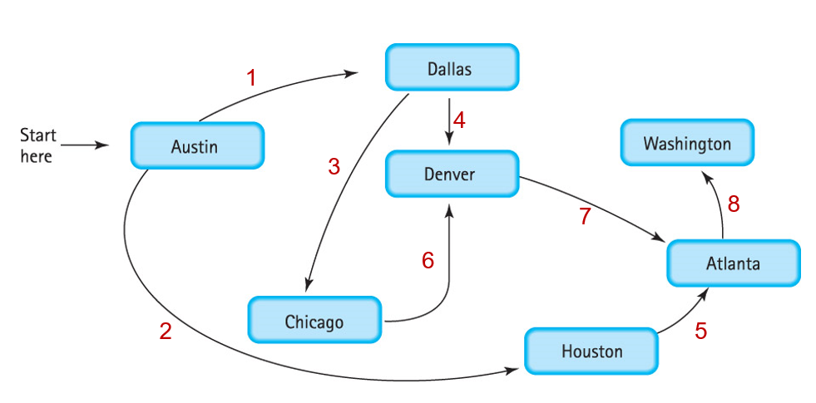
Breadth First: Follow Across
BFS uses Queue !

Slide 4
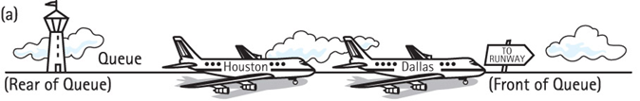




Breadth First Uses Queue

Slide 5
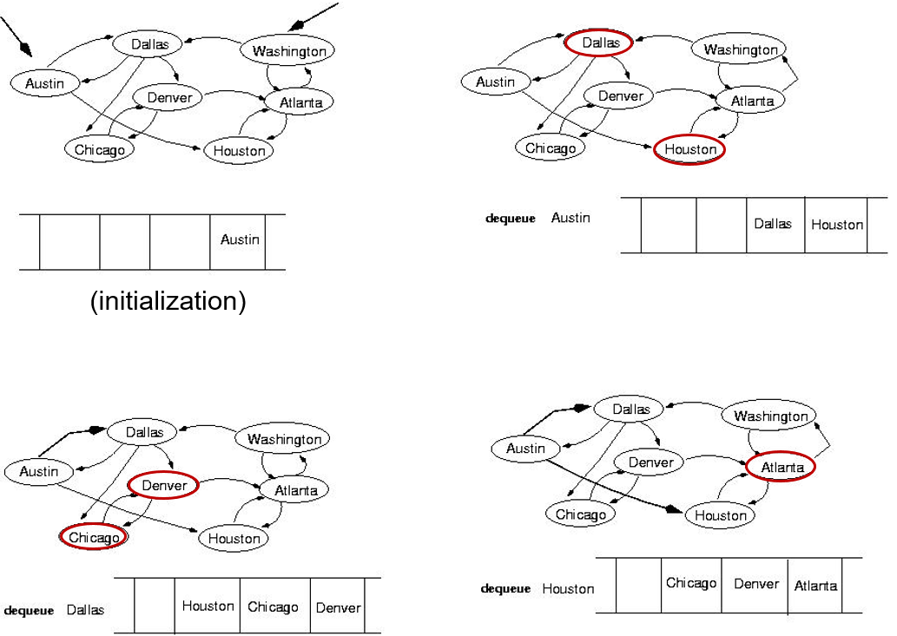
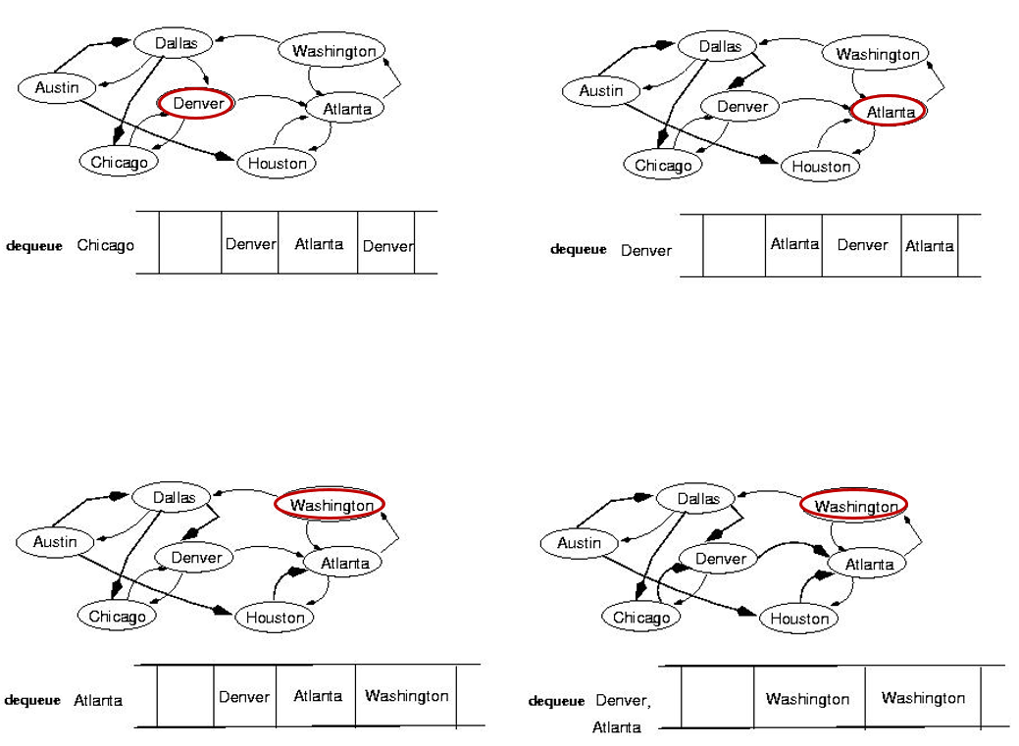

Slide 6
Visualization in Graphs

